Slide 1

PREDICTING THE SUCCESS OF A BANK DIRECT MARKETING CAMPAIGN
TEAM-3
SRILEKHA LAVA
SAI PRANATHI KATTIGE
SIDDHESH KULKARNI
HARSHAVARDHAN

Slide 2
AGENDA
OVERVIEW & OBJECTIVE
BUSINESS VALUE
PROBLEM STATEMENT
DATA TREATMENT
FEATURE SELECTION
MODEL COMPARISION
BUSINESS INSIGHTS
RECOMMENDATIONS

Slide 3
OVERVIEW & OBJECTIVE
Approach to predict the success of a campaign
Customers to be targeted for the next campaign
Increase campaign efficiency
OPIM 5604 PREDICTIVE MODELING

Slide 4

BUSINESS VALUE
Customer Acquisition and Retention.
Increase in Customer Base
Factors influencing Customer’s
decision
OPIM 5604 PREDICTIVE MODELING

Slide 5
PROBLEM STATEMENT
Portuguese Bank Term Deposit Subscription
45211 Observations and 20 input variables
Telemarketing Campaigns
OPIM 5604 PREDICTIVE MODELING

Slide 6
PROBLEM STATEMENT
Variables include
Telemarketing attributes
Campaign - number of phone calls performed
Pdays - No of days that passed by
Previous - number of contacts performed before
Poutcome - previous outcome
Month - last contact month
Duration - duration of the contact
Day of week - last contact day
OPIM 5604 PREDICTIVE MODELING

Slide 7
PROBLEM STATEMENT
Bank Client Data
Age
Job
Marital status
Education
Default
Loan
Housing
OPIM 5604 PREDICTIVE MODELING

Slide 8
PROBLEM STATEMENT
Social and Economic Context attributes
Emp.var.rate - employment variation rate
nr.employed - number of employees
Euribor3m - euribor 3 month rate
OPIM 5604 PREDICTIVE MODELING

Slide 9
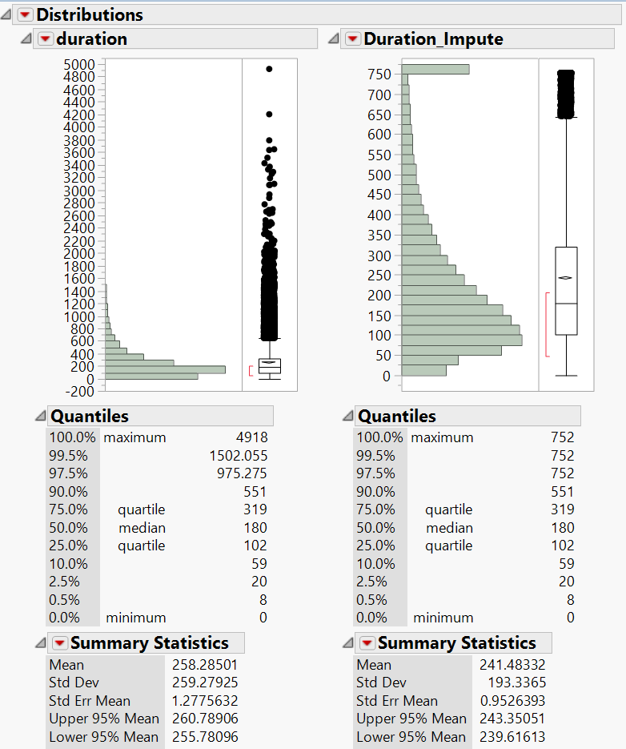
OUTLIER TREATMENT
Imputed Outliers with the best maximum value
Eg., Distribution of duration before and after imputation with 99% value - 752.65

Slide 10
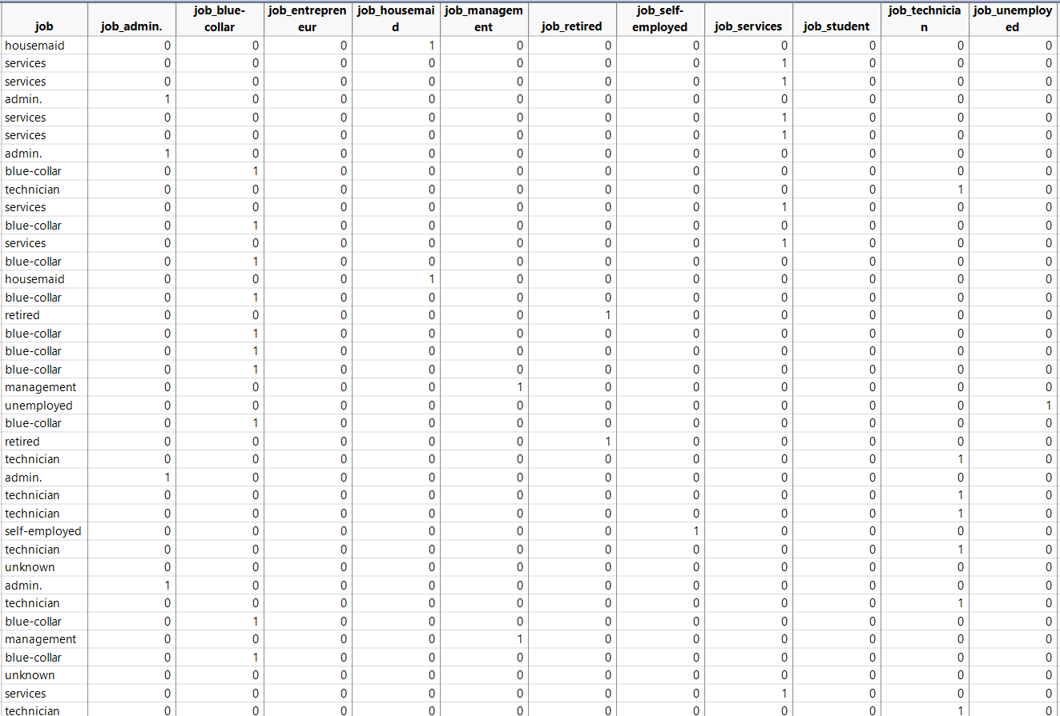
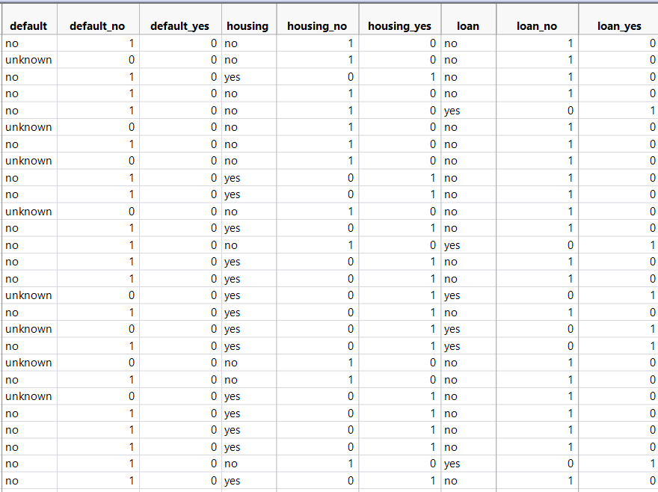
DUMMY VARIABLES CREATION
Created dummy variables for n-1 levels of the categorical variables with “unknown” category if present as baseline

Slide 11
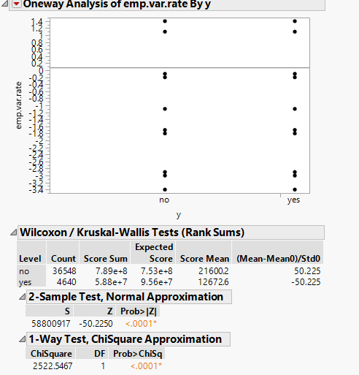
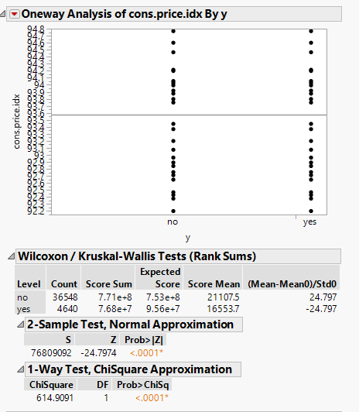
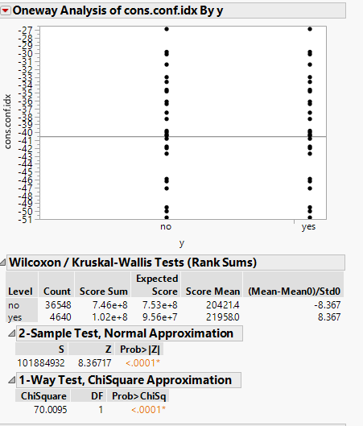
NON-PARAMETRIC ANOVA

Slide 12
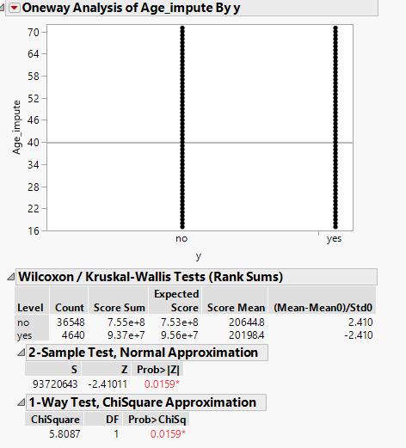
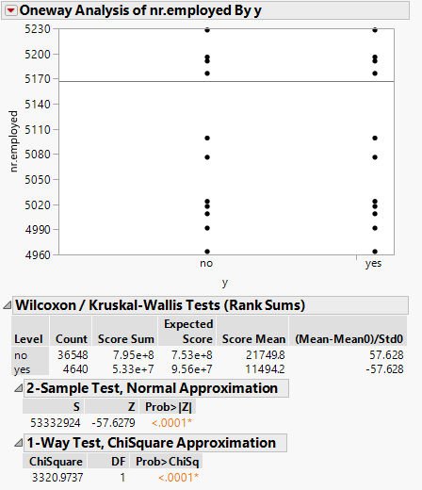
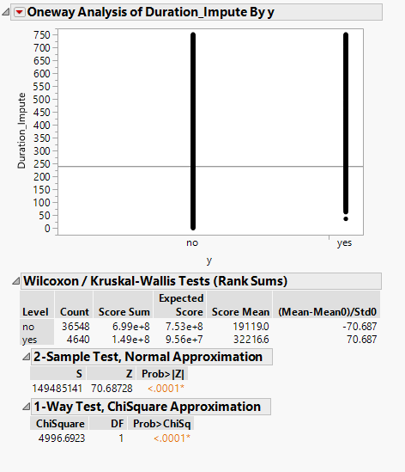
NON-PARAMETRIC ANOVA
Conclusion: All these variable has impact on the response variables

Slide 13
FEATURE SELECTION
Chi-square Significance testing on categorical variables:
Presence of Housing Loan or Personal Loan did not have a significant impact on the subscription response as their p-value>0.05
ANOVA on numeric variables:
Tested if the variables had significant mean difference between the responders and non-responders

Slide 14
MODEL COMPARISON
Split the dataset into training(60%), validation(20%) and test (20%)
Bootstrap Forest gives the best fit model on the test dataset
Model | AUC on Test Dataset | Std. Error | FPR
Bootstrap Forest | 0.9462 | 0.13 | 1.71
Boosted Tree | 0.9399 | 0.13 | 3.34
Logistic Regression | 0.9386 | 0.13 | 2.91
Neural Network | 0.9343 | 0.14 | 2.5

Slide 15
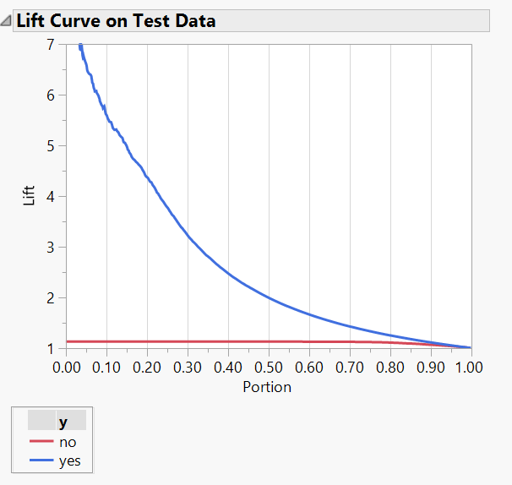
LIFT CURVE OF BOOTSTRAP FOREST ON TEST DATASET
Target top 5% of customers as they are 7 times more likely to respond to the direct marketing campaign

Slide 16
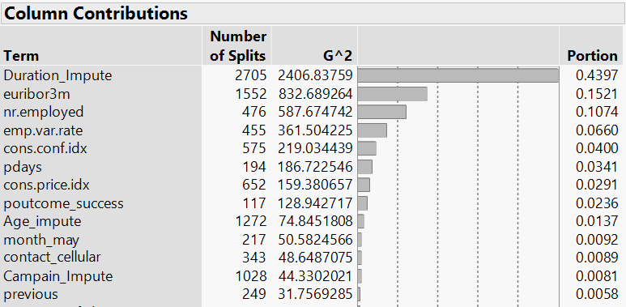
SIGNIFICANT VARIABLES

Slide 17
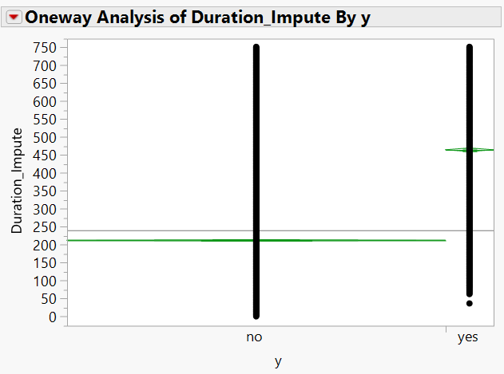
~4.5 MINUTES OF MEAN CALL DURATION DIFFERENCE
As Duration of phone call with customer increases, the chances of responding to the campaign increases
Recommendation-
Interact for at least 1 minute with the customer for positive response

Slide 18
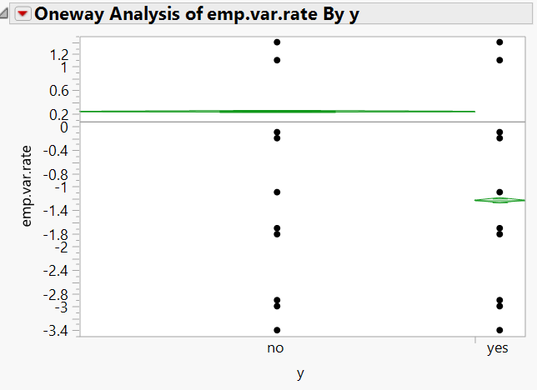
EMPLOYMENT STABILITY --> MORE CUSTOMER TRUST
Recommendation-
Increase customer confidence by sustaining stable employment rate

Slide 19
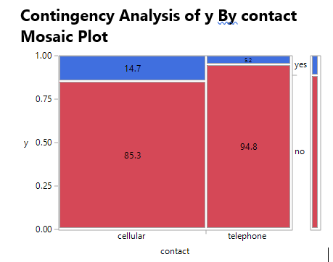
CALL CUSTOMERS DIRECTLY ON THEIR CELL FOR BETTER IMPACT

Slide 20
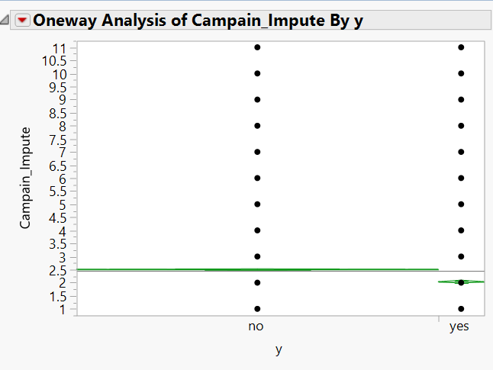
AVERAGE OPTIMUM # OF CONTACTS FOR THE CAMPAIGN IS 2
Recommendation-
More contacts leads to the customers feeling intruded, hence keep the # of direct marketing campaign contacts low

Slide 21
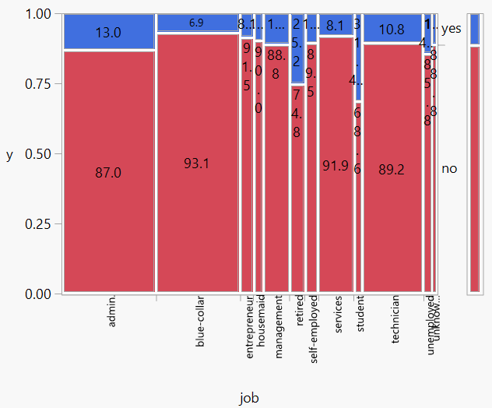
BLUE-COLLARED PROFESSIONALS ARE LESS LIKELY TO RESPOND POSITIVELY
Recommendation-
Target more administrative professionals and students for an effective campaign

Slide 22
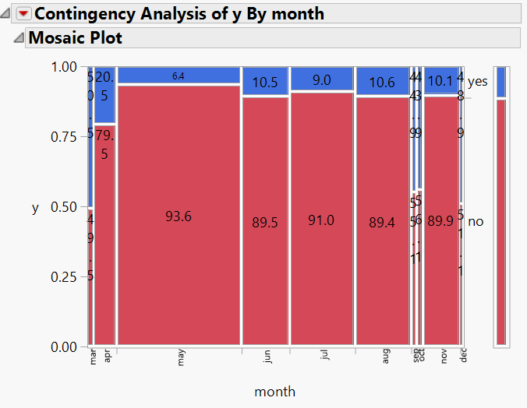
LEAST SUBSCRIPTION IS OBSERVED IN SUMMER BREAK
Recommendation-
Launch campaign during the tax filing month(March/April) or at the end of the year

Slide 23
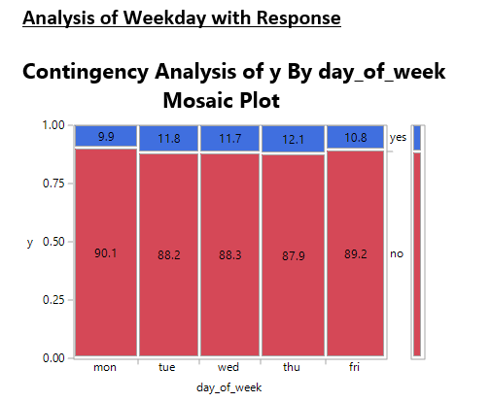
CONTACT CUSTOMERS DURING THE MIDDLE OF THE WEEK

Slide 24
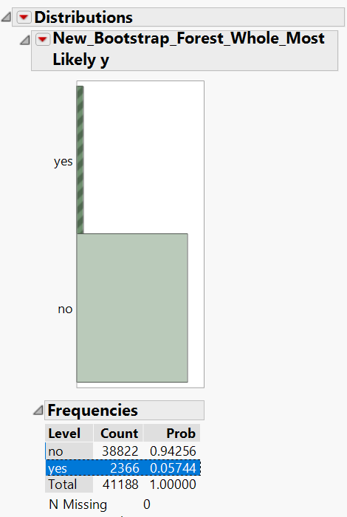
~11% OF CUSTOMERS ARE LIKELY TO RESPOND AS OBSERVED FROM THE TEST DATASET

Slide 25
QUESTIONS?

